Slide 1

Options Evening 24th February 2026
Please ensure that you have picked up a paper Options Booklet to refer to after the presentation.
KEY DATES FOR YOUR DIARY:
Year 9 Consultation evening: Wednesday 11th March
Option form Deadline: Monday 16th March
(link to the online form will be sent to each student’s email account following Options Evening)
SLIDES FROM THIS PRESENTATION WILL BE SENT OUT TOMORROW MORNING

Slide 2

You are closer to the end of Year 11 than you are to the start of Year 7!

Slide 3
During the secondary school journey so far…
You have made gargoyles with clay in Art
Performed with masks in Drama
Sung in front of your peers in Music
Played all sports of new sports in PE
Learnt how to code with Python in ITACs
Learnt a new language… or maybe two!
Created bunting in Textiles
Made a speaker, lush box, apple crumbles and a working clock in technology

Slide 4
During the secondary school journey so far…
Some of you have represented the school on the stage, in choirs, in sports teams
You’ve been on trips in this country and overseas
Joined together for Colour Run, activities weeks, PSHE days and sports day
You’ve made new friendships, worked with lots of teachers and found your way around the school
You’ve had assessments, learnt revision strategies and are confident using Teams and other learning platforms
You’ve had to be organised with stationary, home learning, PE kit and food ingredients
You’ve had some mini choices with creative options
You are ready for the next step

Slide 5

Aim of this short presentation:
To make the option choices available to students clear
To offer advice on how to make these decisions
To clarify the key dates

Slide 6


Slide 7

Creating your curriculum

Slide 8




1. Compulsory subjects
English: 2 GCSEs: English Language and English Literature.
Maths: 1 GCSE in Mathematics.
Science: 2 GCSEs called Combined Science
PSHE: No examination

Slide 9

You will have a CORE PE lesson per week unless you choose to swap it for Performing Arts.
There are no qualifications for these subjects – the focus is to keep students physically active and maintain physical, mental and social well-being!

Slide 10

2. Optional section of the curriculum
Each subject within an option block is taught at the same time.
The options have been grouped into blocks based on a number of variables including our staff and facility availability.
You need to choose 1 subject per block

Slide 11
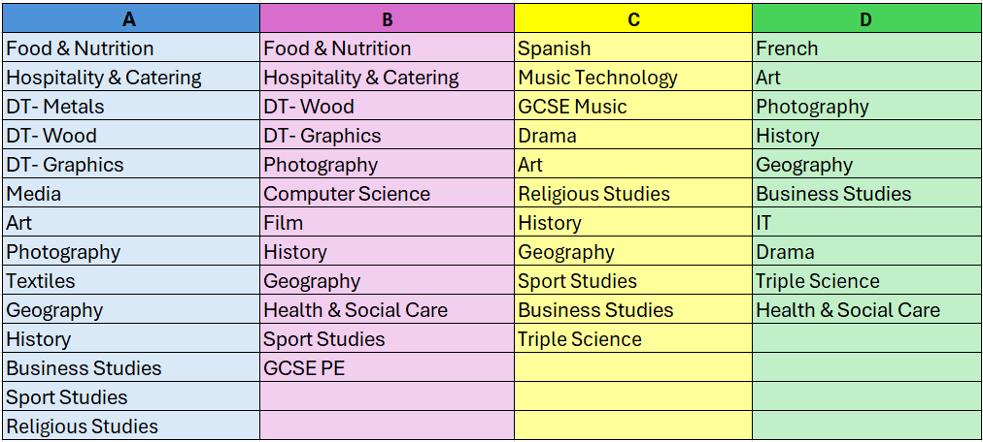
Optional section of the curriculum
KS4 Options 2025

Slide 12
Optional section of the curriculum
If you take 1 language, this must be the one that you studied in Years 7, 8 & 9.
You can take 2 languages if you studied the second one as a creative option in Year 9.
If you do not take a Language, you must choose History or Geography.

Slide 13
Optional section of the curriculum
You can’t take…
Art and textiles
More than one DT
GCSE PE and Sport Studies
Media and Film

Slide 14
Optional section of the curriculum
Why is it worth considering a Vocational course?
The course will have a number of units that are assessed throughout Y10 & 11.
They have exams, but these are worth a smaller % of the course and so overall you will likely have fewer exams at the end of Year 11.

Slide 15


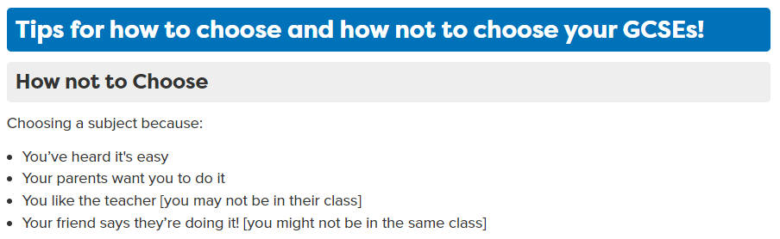
Which subjects do you enjoy?
Which subjects do you excel in?
Which subjects would you wake up in the morning and look forward to studying?

Slide 16

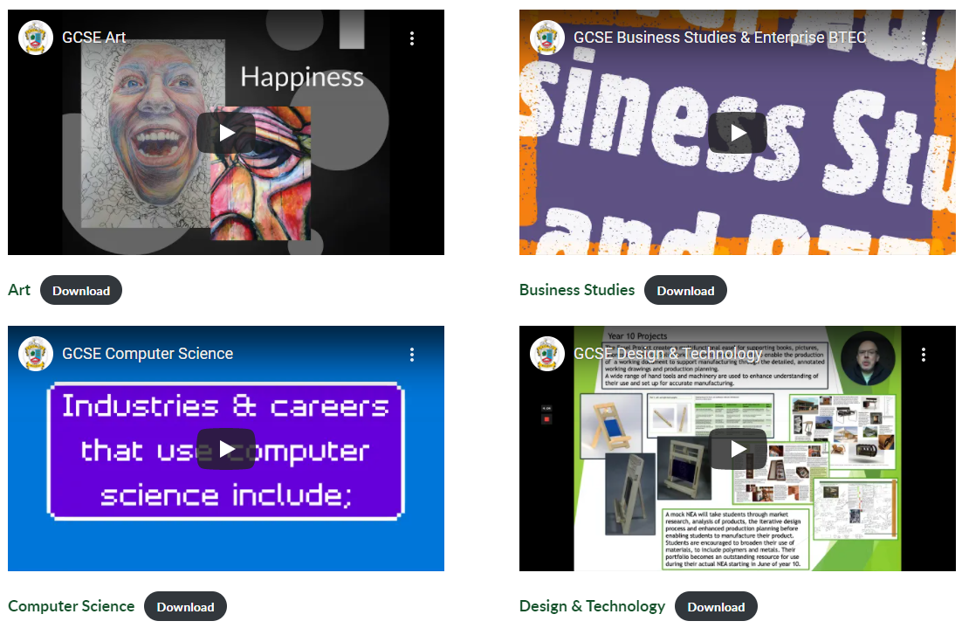
We have created a KS4 options page on the school website (go to Academic → KS4 Options)
Here you can watch short videos created by each department to understand what each subject will be like in Years 10 & 11.
There is also a download under the video which details the course including information about the exam board and why you might want to take it.
Ringwood School - KS4 Options

Slide 17

Q: What about my future careers?
There aren’t many careers that require you to have studied particular GCSEs (e.g. you don’t have to have studied triple science to do medicine or be a vet!)
Breadth is often key… for example, surgeons are required to have good hand skills, creativity and problem solving skills so Art or Technology would be beneficial!
But, some GCSEs do give you a good understanding in a subject before you go on to study it in more depth at A level (that’s not to say it is necessary to study them)

Slide 18
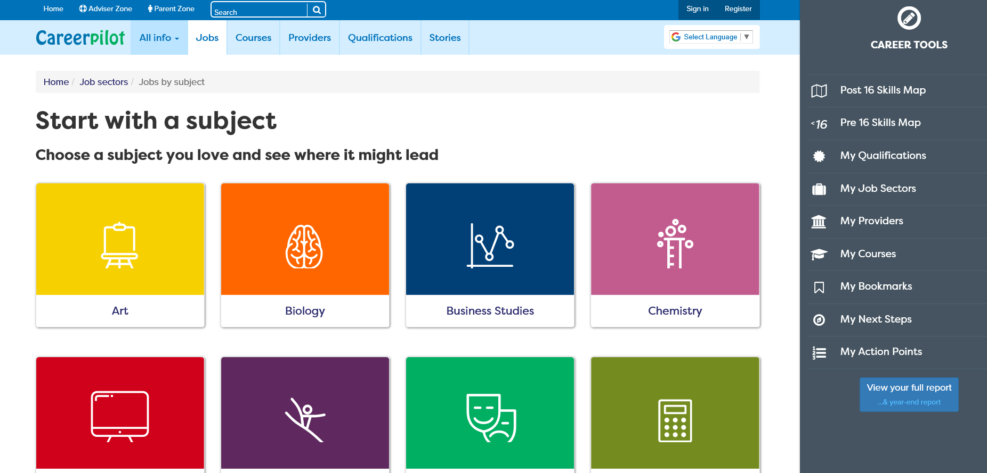
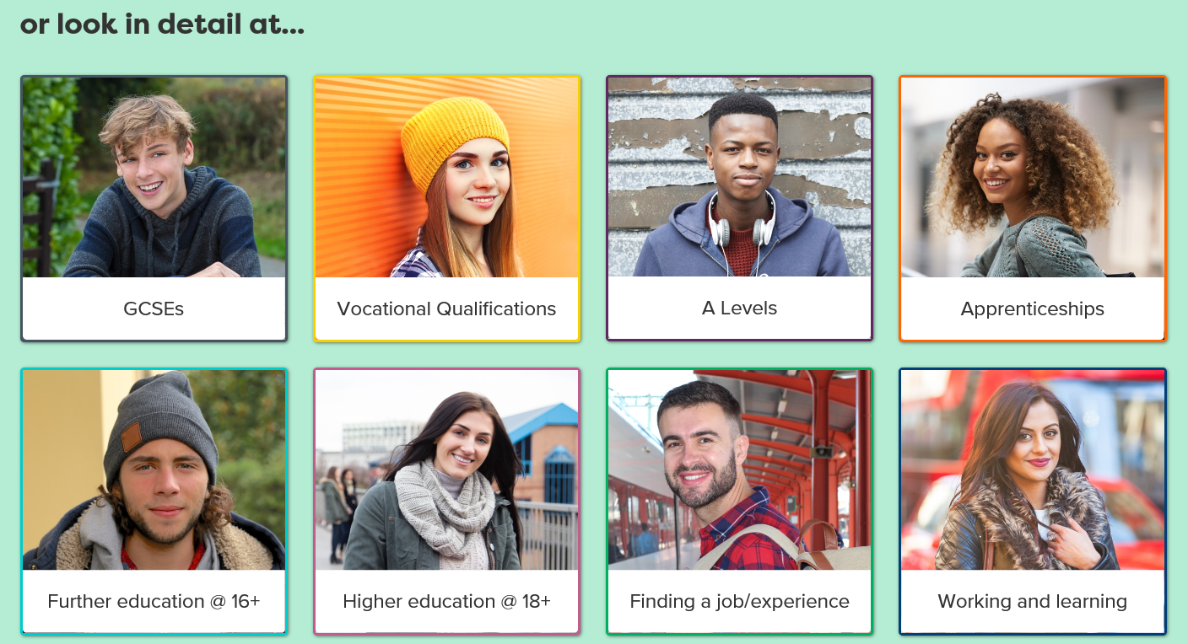
https://careerpilot.org.uk/job-sectors/subjects
A super website to help students consider careers linked to certain subjects…
…and it also includes information about vocational qualifications, post 16 courses, finding work experience etc.

Slide 19
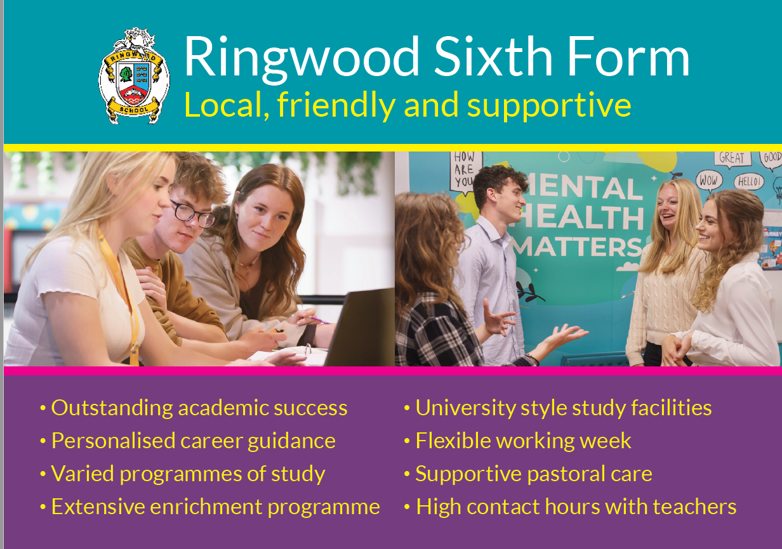

Slide 20

Who can I ask for help?
Year 9 Parents Evening
Parents/Carers
Tutors
Head of Year or
Mrs Barker-Garrod
The subject leader & subject teachers that are now waiting for you to visit them!
Option Video Website

Slide 21


The Caveat… You might not get everything you want…
I cannot move the subject from the current option block – it’s there for a reason.
If an option does not attract enough students, it may not be viable to run. In the current educational climate, we cannot afford to run small classes. If a course isn’t viable, we will contact the student to advise them to repick.
Equally, an option may attract more students than the class can accommodate (30 for most subjects but 22 for Technology subjects like Food/ DT and 21 for Photography).
If we cannot create an extra group for an oversubscribed option, then the limited places that are available will be allocated according to students’ behaviour records and their achievements both within and outside of school in that subject.
I also reserve the right to prevent a student from studying a practical course such as Food or Engineering if they are deemed to be a Health & Safety risk to themselves or others.

Slide 22

What to do now:
Visit the subject teachers that are waiting for you in classrooms
Visit the options page on the school website and watch the videos of the subjects you are interested in.
Talk to your parents/carers as well as your teachers at parents evening.
Complete the online options form which will be sent to the students email account (I’ll send this tomorrow morning). The deadline is Monday 16th March.

Slide 23
Those invited to attend the meeting with Mrs Sutton and Mrs Lee, please come down to the front few rows – the meeting will begin in 10 mins

Slide 24

CoPE – The Certificate of Personal Effectiveness What is it?
The qualification is a nationally recognised qualification available at Level 1 and Level 2
It offers imaginative ways of accrediting young people’s activities and introduces them to new challenges.
Challenges are chosen based on the students' interests. They include:
Communication
Sport and Leisure
Independent Living
Health and Fitness
Work related learning, and many more
Students will develop and be assessed on six key skills, while carrying out the challenges:
Working with others
Improving their own learning and performance
Problem solving
Research
Discussion
Oral presentation

Slide 25
CoPE – The Certificate of Personal Effectiveness What are the benefits?
CoPE enables students to:
develop and demonstrate a range of personal, key and employability skills
broaden their experience
manage their learning in a variety of real-life contexts
The qualification is practical, engaging and more personalised. There is no need for revision as there are no end of year exams.

